Slide 1

Proposing Shows in University Theater
August 2021 Town Hall

Slide 2
How have UT Proposals Historically Worked?
Once upon a time…
Mainstage proposals were due 3rd week of the quarter prior to the performing quarter
Workshops were due 6th week of the quarter prior to the performing quarter
Shows would take the rest of that prior quarter to prepare designs, talk to Pro Staff, etc. (Design Conference 7th week, Uber Prod 10th week)
Auditions happened the first week of the performance quarter
Shows go up anywhere between 6th and 10th week
All Mainstage shows got $2,500, all Dean’s Men FXK shows got $1,500, Workshops got $250
Notes:
Highlight that these weeks are tough with the smaller timeline. And honestly, a lot of shows are tough in 10 weeks

Slide 3
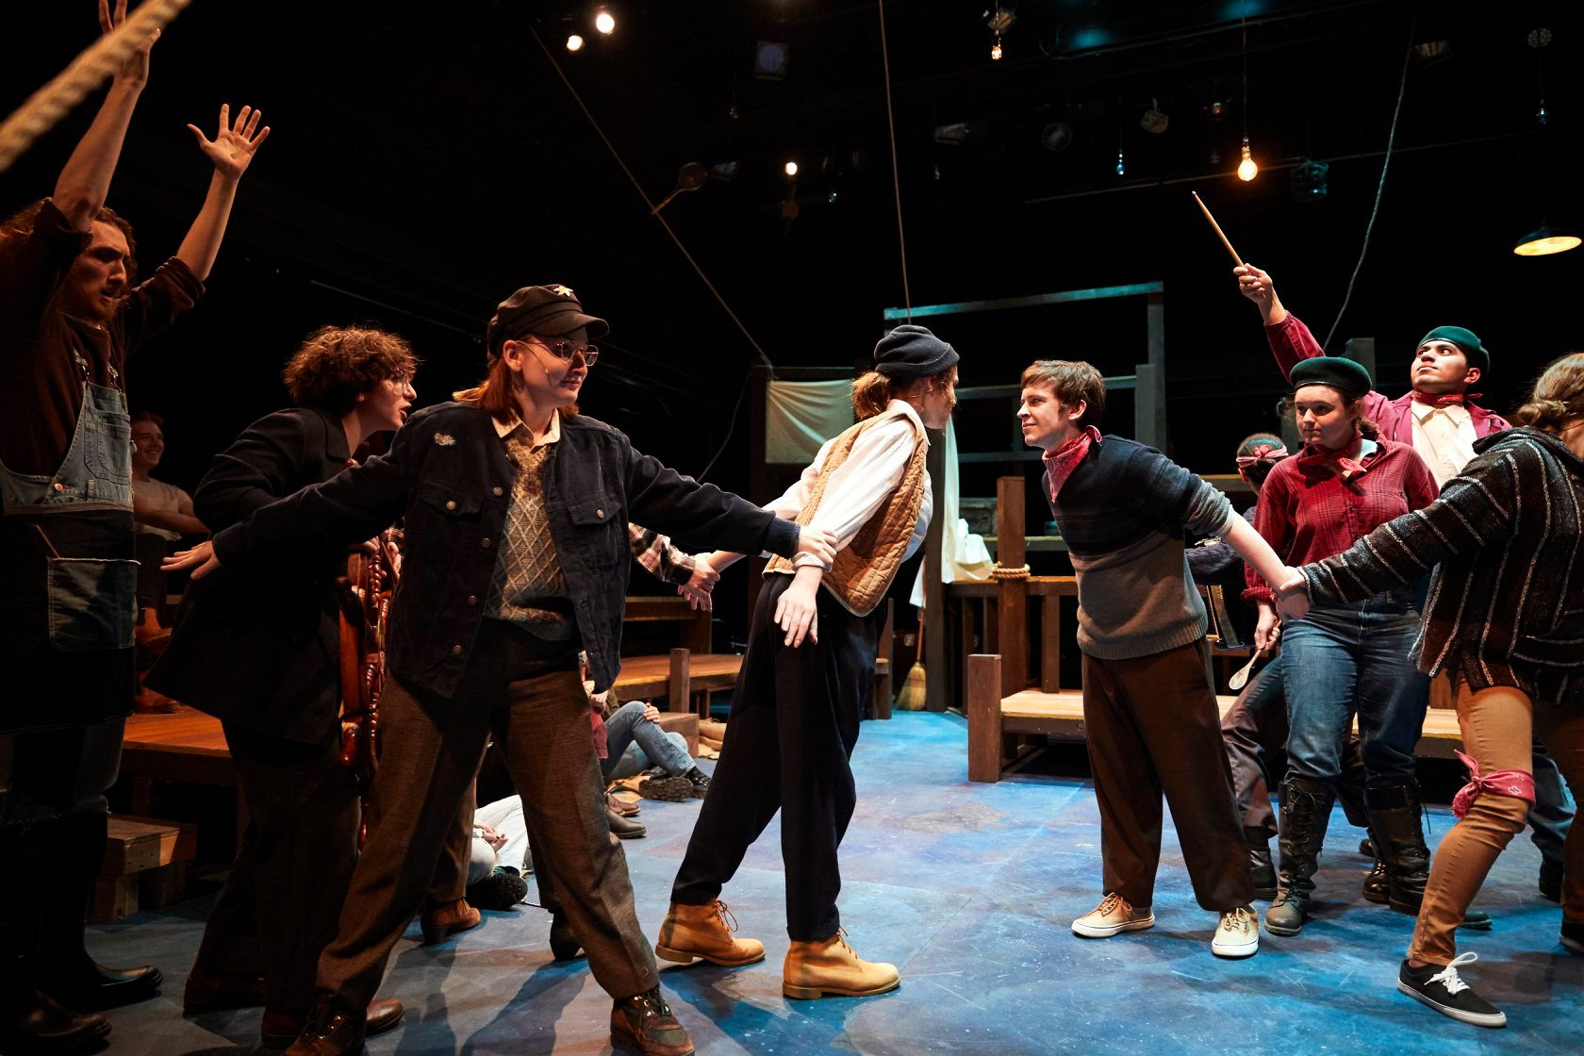
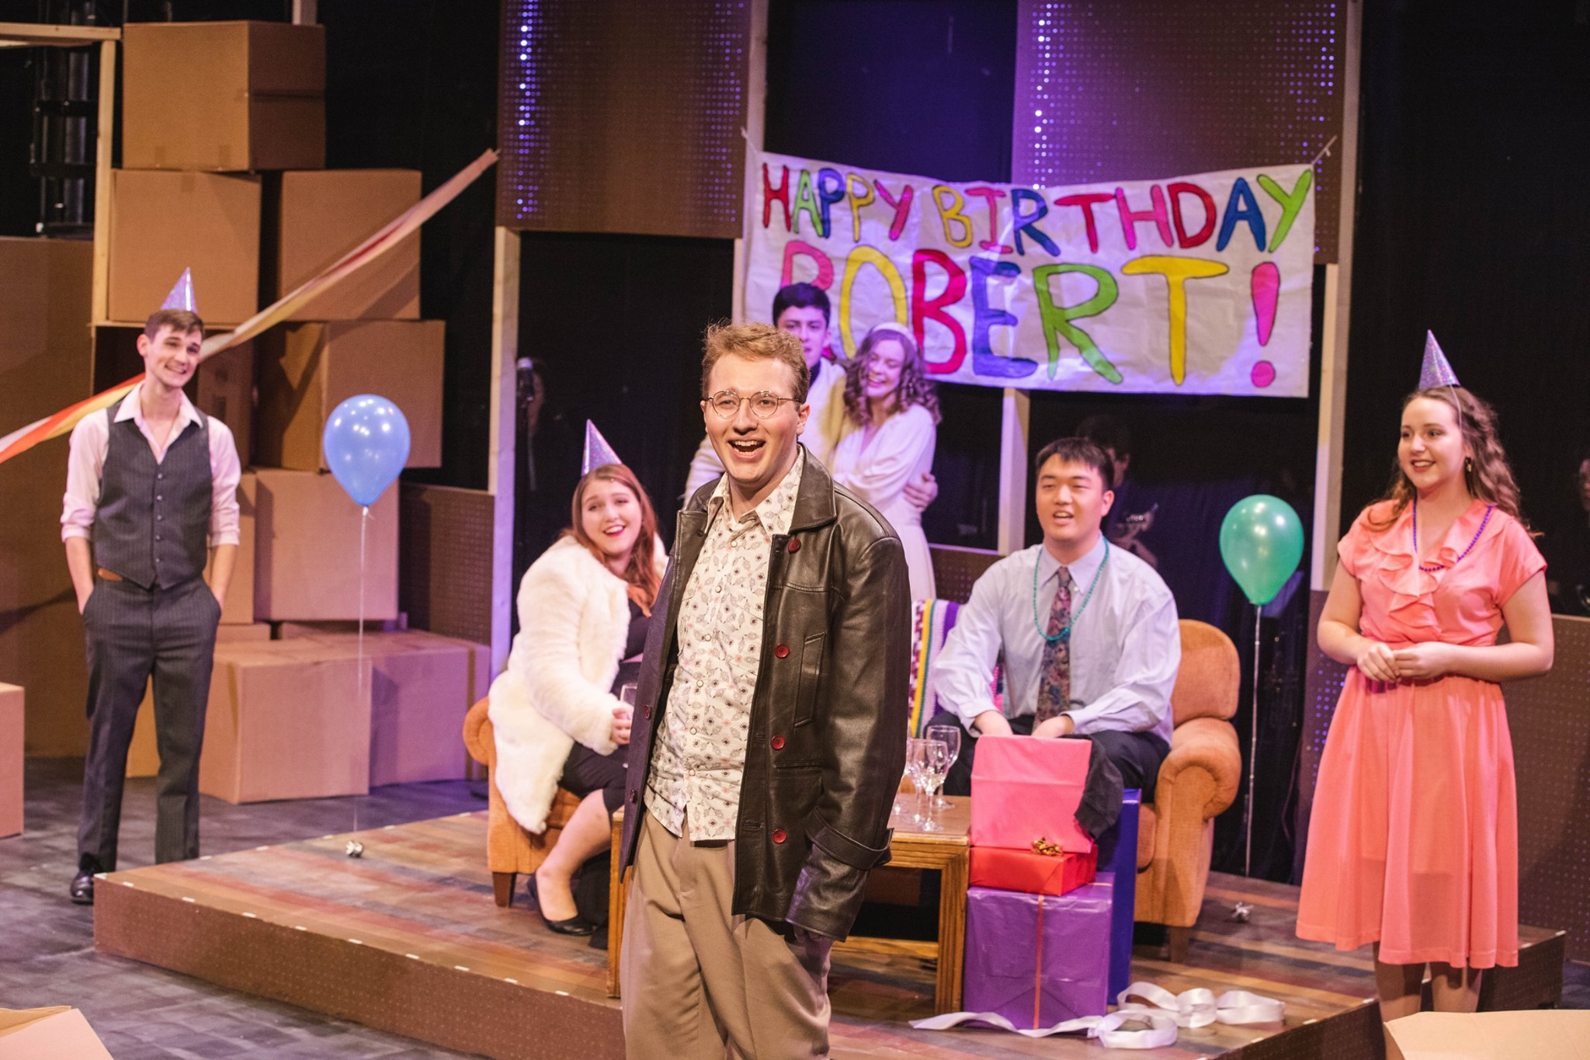
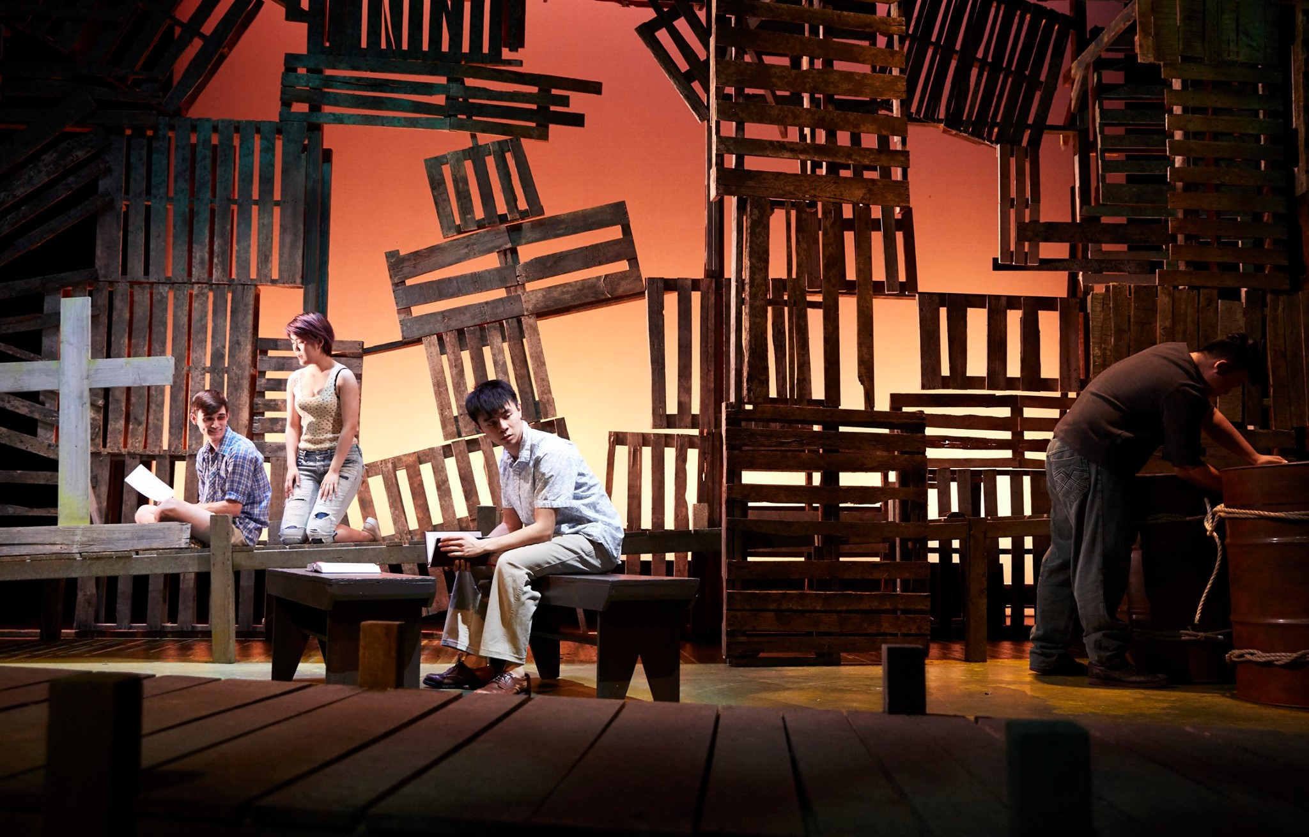
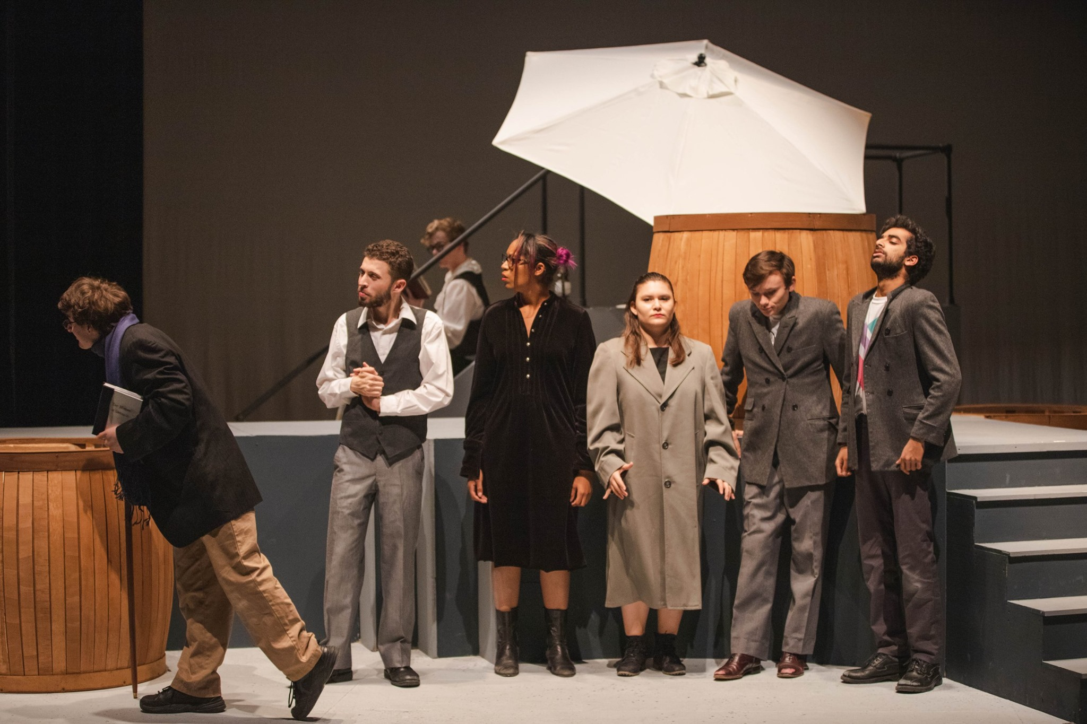
Performance Locations
Theater West: configurable black box theater in Logan
Theater East: proscenium theater in Logan

Slide 4
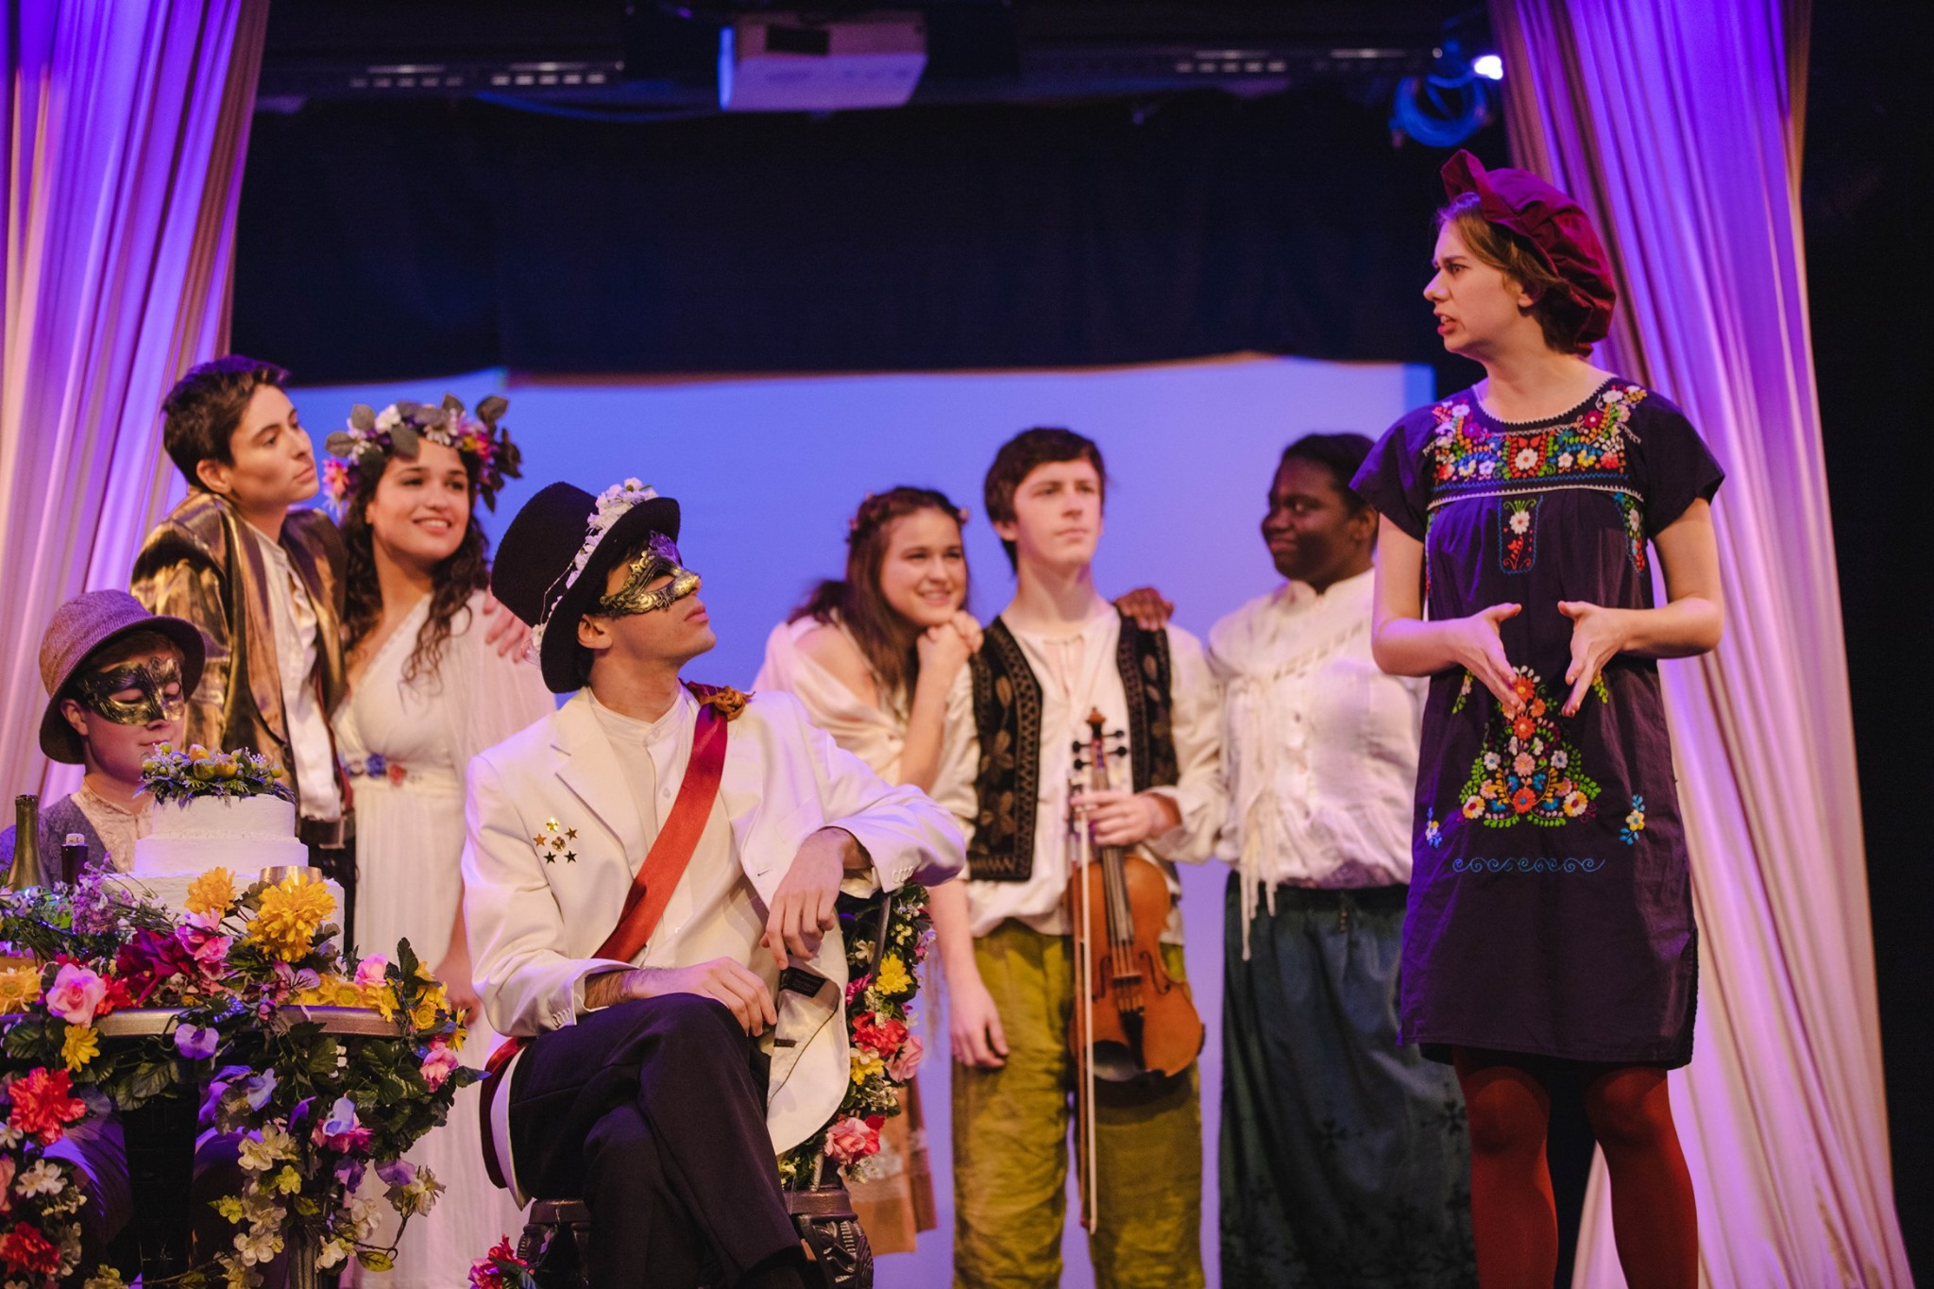
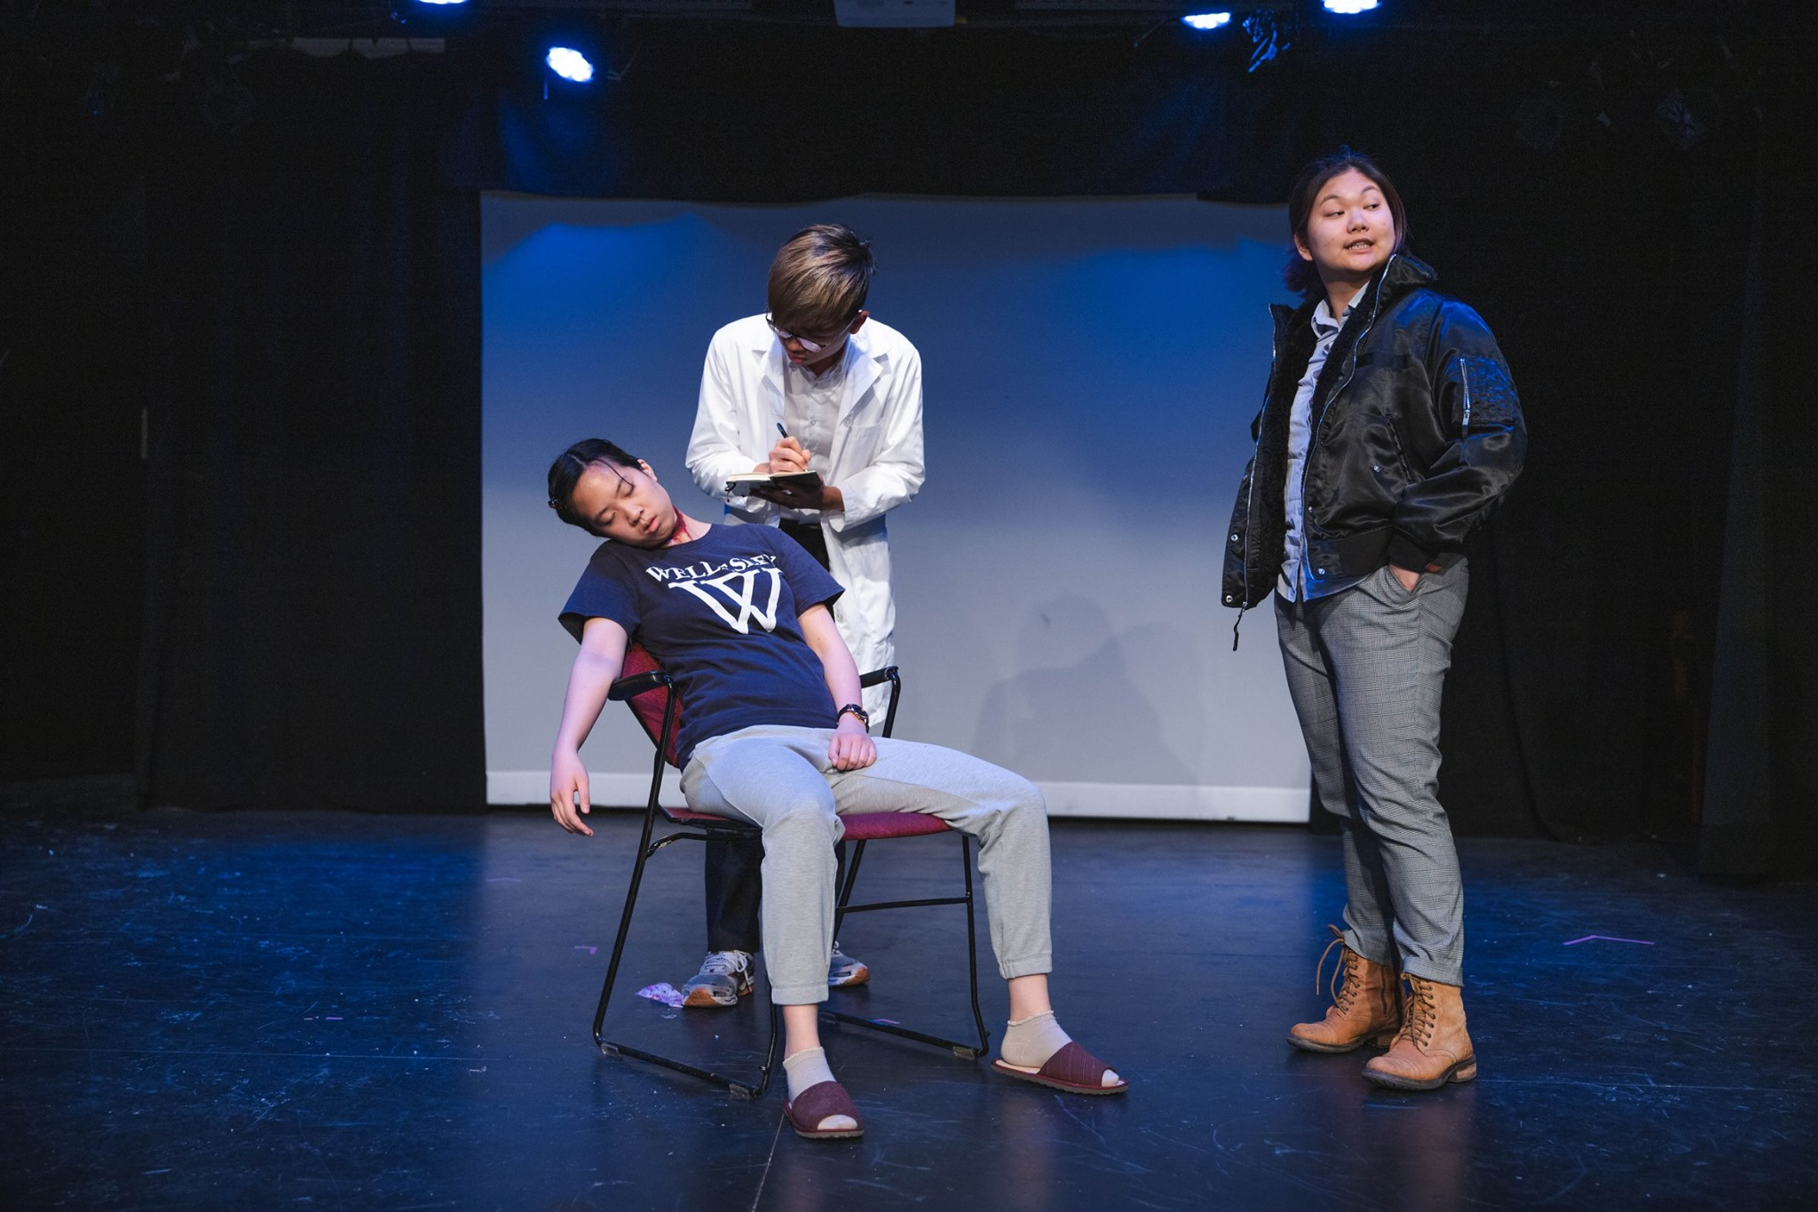
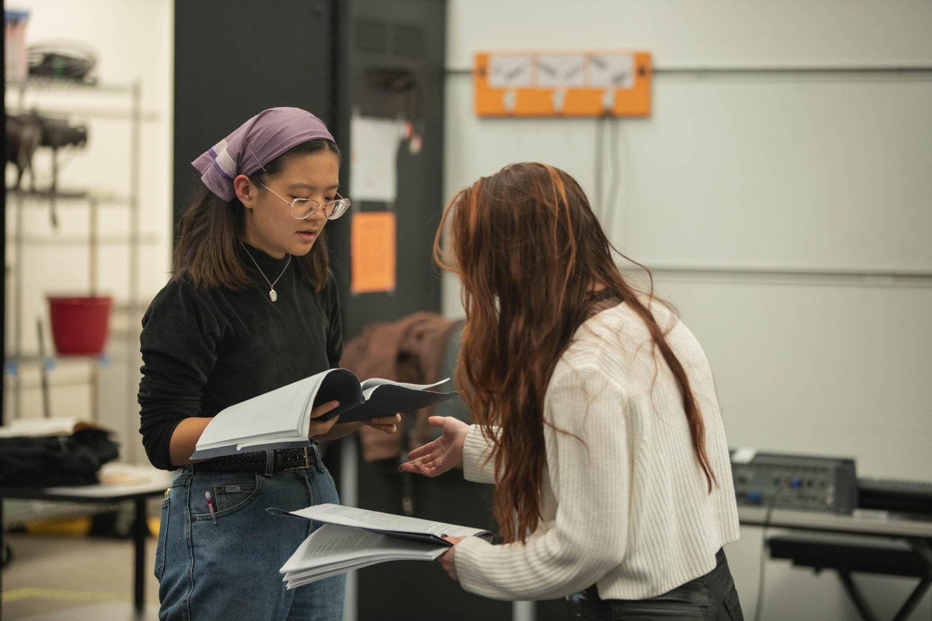
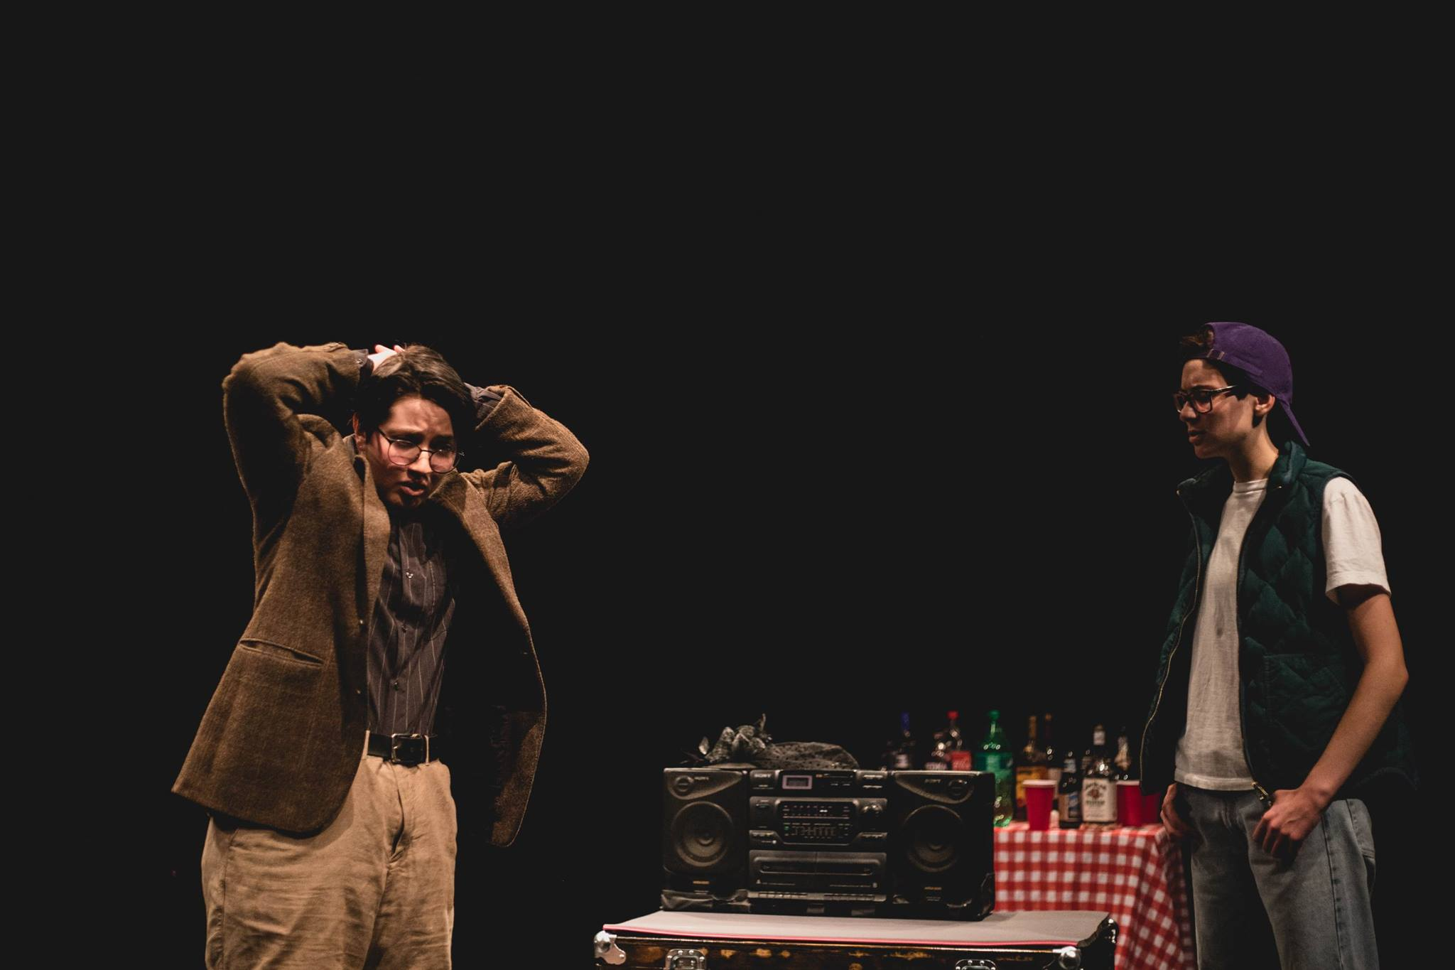
Francis X Kinahan Theater: proscenium theater in the Reynolds Club, used for workshops and Dean’s Men shows
Logan 501: performance lab used for rehearsals and site-specific work
and more! (Logan Quad, main quad, Logan 701…)

Slide 5
The (Proposed) Proposal Process

Slide 6
Types of Work
One-Quarter Shows - Performances take place in the FXK, Theater East, or Theater West during 7th or 8th week each quarter and are passed one quarter prior to the quarter of their performance. All Dean’s Men shows are One-Quarter shows, with the exception of the spring trunk show.
Cross-Quarter Shows - Performances take place Theater East or Theater West during the 6th week of Winter and Spring Quarter and are passed two quarters prior to the quarter of their performance. The cross-quarter model is intended for productions that want more flexible rehearsal scheduling, increased rehearsal time to accommodate performance duration, and/or additional time to develop design elements.
Collaborations - RSOs may propose to collaborate with UT to produce one-quarter and cross-quarter shows.
Site Specific Work - Performance pieces and installations that are located in Logan 501 or other locations on campus. These may be one-quarter or cross-quarter shows, depending on location.
Workshops - Performances take place during 5th week of Fall and Winter Quarters and are passed one quarter prior to the quarter of their performance through the beginning of the performance quarter. Workshops are intended for works, particularly new or student-written work, with a shorter runtime and minimal stage design.

Slide 7
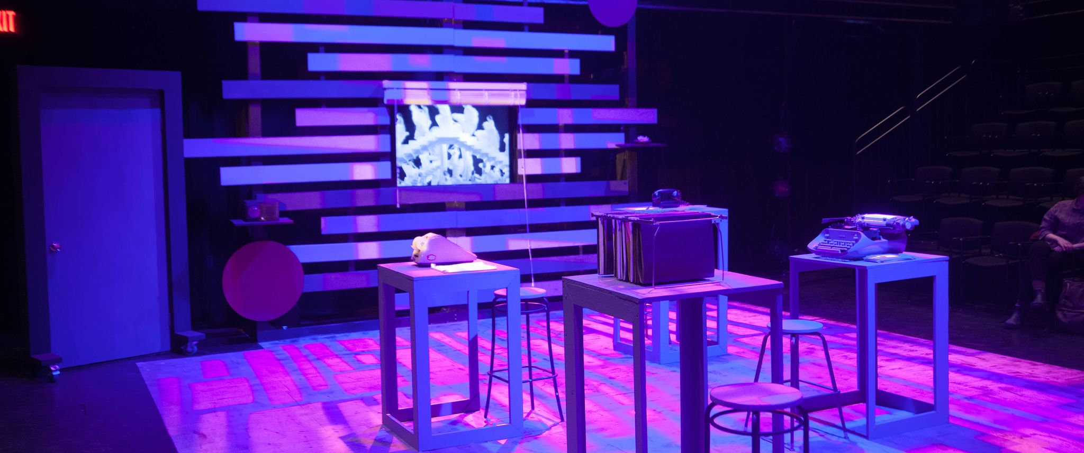
Types of Work - Examples
Cross-Quarter Shows
One Quarter Shows
Machinal, Winter 2019
The Winter’s Tale, Fall 2020
Ever in the Glades, Winter 2020

Slide 8

Types of Work - Examples
Workshops
Site-Specific Shows
The Asian Crime Show Play (Weekend of Workshops), Winter 2020
Twelfth Night, Spring 2019

Slide 9
Year Overview Calendar
Autumn
2nd Week: Propose one quarter show for Winter and cross quarter show for Spring
4th Week: Workshops
6th and 8th Week: Mainstage shows
7th or 9th Week: Dean’s Men show
Winter
2nd Week: Propose one quarter show for Spring and cross quarter show for Autumn
4th Week: Workshops
6th and 8th Week: Mainstage shows
7th or 9th Week: Dean’s Men show
Spring
2nd Week: Propose one quarter show for Autumn and cross quarter show for Winter
4th Week: Workshops
6th and 8th Week: Mainstage shows
7th or 9th Week: Dean’s Men show
Notes:
So I dont think this was the ideal thing to put here but I wasn’t quite sure… I kept it simple bc I think we’re throwing a lot of stuff at them, so it’s more bare bones ‘this is what you need to know’ versus all of pre prod, etc

Slide 10
Year Overview Calendar
Autumn
2nd Week: Propose one quarter show for Winter and cross quarter show for Spring
4th Week: Workshops
6th and 8th Week: Mainstage shows
7th or 9th Week: Dean’s Men show
Winter
2nd Week: Propose one quarter show for Spring and cross quarter show for Autumn
4th Week: Workshops
6th and 8th Week: Mainstage shows
7th or 9th Week: Dean’s Men show
Spring
2nd Week: Propose one quarter show for Autumn and cross quarter show for Winter
4th Week: Workshops
6th and 8th Week: Mainstage shows
7th or 9th Week: Dean’s Men show
Notes:
So I dont think this was the ideal thing to put here but I wasn’t quite sure… I kept it simple bc I think we’re throwing a lot of stuff at them, so it’s more bare bones ‘this is what you need to know’ versus all of pre prod, etc

Slide 11
Year Overview Calendar
Autumn
2nd Week: Propose one quarter show for Winter and cross quarter show for Spring
4th Week: Workshops
6th and 8th Week: Mainstage shows
7th or 9th Week: Dean’s Men show
Winter
2nd Week: Propose one quarter show for Spring and cross quarter show for Autumn
4th Week: Workshops
6th and 8th Week: Mainstage shows
7th or 9th Week: Dean’s Men show
Spring
2nd Week: Propose one quarter show for Autumn and cross quarter show for Winter
4th Week: Workshops
6th and 8th Week: Mainstage shows
7th or 9th Week: Dean’s Men show

Slide 12
Year Overview Calendar
Autumn
2nd Week: Propose one quarter show for Winter and cross quarter show for Spring
4th Week: Workshops
6th and 8th Week: Mainstage shows
7th or 9th Week: Dean’s Men show
Winter
2nd Week: Propose one quarter show for Spring and cross quarter show for Autumn
4th Week: Workshops
6th and 8th Week: Mainstage shows
7th or 9th Week: Dean’s Men show
Spring
2nd Week: Propose one quarter show for Autumn and cross quarter show for Winter
4th Week: Workshops
6th and 8th Week: Mainstage shows
7th or 9th Week: Dean’s Men show
Notes:
6/7/8 or 7/8/9- which is better?
6th week is for cross-quarter, 8th is one-quarter
If a CQ isn’t passed, then that can be filled with a smaller 1Q

Slide 13
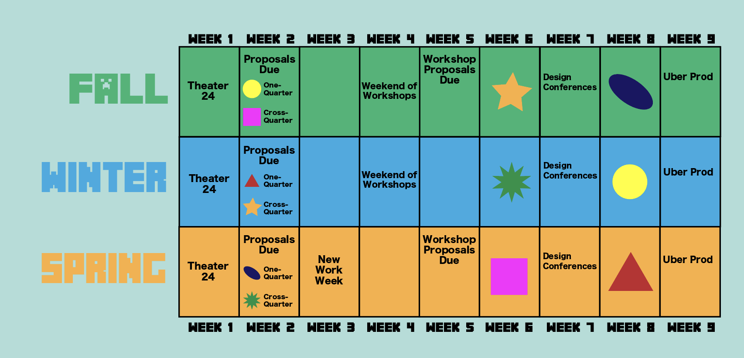
Year Overview Calendar: Example

Slide 14
Budgeting (Proposed)*
Timeline:
2nd Week (Fri): Proposals Due
A proposed rough budget to the nearest $500 is due
3rd Week (Fri): Shows Announced
8th Week (Fri): Uber Prod Budget Finalized
Itemized budgets due to Committee, and may be adjusted up to $500 from proposed budget (w/i cap)
9th Week: Uber Prod
Itemized budgets presented to pro-staff during Uber Prod
3rd Week (Fri) (Performance Quarter)
Deadline by which One-Quarter and Cross-Quarter shows may apply for up to $1,000 beyond Uber Prod budget
Cross-Quarter - up to $5,000
One-Quarter - up to $3,000
Workshops - up to $250
Collaborations & Site-Specific - varies
*We are still trying to figure out what an appropriate budget and budget timeline would look like for each show and would love your feedback!

Slide 15
Proposing Quarter Timeline
2nd Week, Friday 5pm: written mainstage proposals and scripts due to Committee
3rd Week: proposers meet with Committee members individually
3rd Week, Friday 5pm: public mainstage proposal meeting + Q&A
3rd Week, Friday evening: mainstages are passed + announced by Committee
5th Week, Friday 5pm: workshops and site-specific work proposals due
6th Week, Monday 5pm: public workshops and site-specific work proposal meeting
6th Week, Monday evening: workshops and site-specific works are passed
8th Week, Friday: mainstage final budgets submitted prior to Uber Prod in 9th week

Slide 16
Performance Quarter Timeline
1st Week, Tuesday through Thursday: auditions
3rd Week, Friday: last day to submit a budget extension request for shows performing in current quarter
4th/5th Week: workshop performances
6th-8th Week: performances of Single-Quarter show(s) and Cross-Quarter show (passed two quarters prior)

Slide 17
Assembling a Team
Assembling a team is tough. We want to address that.
Continue sending out quarterly “interest forms” to the community
Allows new members to express interest and get their name out there w/o previously knowing someone
Allows proposers to get find and reach out to interested designers who they may not otherwise know
Later in the process, can be used for finding assistants as well

Slide 18
Assembling a Team
An important note on proposing:
Since we’re asking for the proposals a week earlier, we want to be cognizant of the fact that assembling a team becomes harder, especially for newer proposers.
This means taking this difficulty into account when evaluating a proposal and being there to help build that team during the proposal process and after.

Slide 19
The Proposal Form & Committee Meetings
Proposal Form:
Name and information about the proposer
Cast size and gender breakdown
Confirmation of meetings with pro-staff
Run time
Space preference
Scale (1 quarter vs. cross quarter)
Rough budget
Three important images pivotal to the play
The driving question and themes behind the production.
The production design aesthetic of the play and the textual justification for the aesthetic choice.
Team summary and staff bios
Optional: the inclusion of rough paperwork and design concepts
In order to submit a show proposal, proposers must complete the proposal form and meet with members of Committee members (likely during Committee office hours) to discuss the proposal.

Slide 20
The Public Proposal Meeting
The community-wide Mainstage Proposal Meeting is held 3rd week, usually Friday at 5pm. The purpose of this meeting is for the UT community to learn more about each proposal in advance of the selection process by Committee.
At the Mainstage Proposal Meeting, each proposer has one minute to present their proposal and five minutes to answer the questions of Committee and community members.

Slide 21
Pre-Production
Friday of 3rd Week: Shows are passed with rough budgets rounded to the nearest $500.
7th Week: Design Conferences
Friday of 8th Week: Budgets are finalized with up to a $500 increase from the originally-proposed amount.
9th Week: Uber Prod
Cross-Quarter shows: Exact deadlines and meetings for cross-quarter shows are determined in conversation with Pro Staff and Committee
Notes:
We want to give CQ shows the flexibility to use their time in a way that makes sense for their show, which might not be the same each time.

Slide 22
Auditions, Rehearsals & Performances
1st Week: Auditions for current quarter’s One-Quarter show(s), current quarter’s workshops, and Cross-Quarter show performing in following quarter, organized by Committee
Early auditions (e.g. 9th Week of prior quarter) possible in special circumstances, upon request
Cast lists finalized by Friday evening
2nd Week onwards: Shows and workshops rehearse, maintaining in contact with Committee via their Committee Liaison
3rd Week, Friday: Mainstages may apply for additional funding, up to $1000 beyond their Uber Prod budget
6th-8th Week: Mainstage performances occur Thursday through Saturday
Post-mortem occurs the week following performances

Slide 23
Be sure to join the Proposal Changes Subcommittee!
(link: bit.ly/UTDiscord)

Slide 24
Open Questions
What if auditions were earlier? (or just some of them?)
Are the definitions we provided useful? How could we improve them to better reflect the types of shows UT puts on or wants to put on?
We’re asking for proposals a bit earlier. How can we support proposers with this new deadline?
Would formalizing the director/designer matching process be helpful?
In general, how can we support you in this change? Does something become harder? Is something very unclear?
Would mid-show check-ins with Pro Staff be helpful?
Is the proposed budget schedule feasible for you? How could we support?
How would people like Hold Space to work in this process?

Slide 25
Questions & thoughts?

